Slide 1
PIA 3121
6 October 2026
Constructivism

Slide 2
PIA 3121 Schedule
1 Sept: Tools of Analysis / Foundational Concepts
8 Sept: Realism
15 Sept: Liberalism
22 Sept: Neorealism and Neoliberalism
29 Sept: Economic Structuralism and Globalization
6 Oct: Constructivism
13 Oct: MIDTERM QUIZ
20 Oct: Ontological Security Theory
27 Oct: The English School
3 Nov: Democratization / Global Culture / Revolution
10 Nov: Critical Theory / Gender in IR / Global Civil Society
17 Nov: Chaos and Complexity in IR / Existential Risks
24 Nov: FINAL QUIZ / Discussion of Group Projects
8 Dec: GROUP PAPER PROJECT DUE

Slide 3
SOURCE: https://commons.wikimedia.org/wiki/User_talk:Viewsridge

Slide 4
Constructivism
You can’t assume that all states are alike as “rational actors,” because in fact they all vary significantly in their identity: their values, perceptions, aspirations, and ways of looking at the world—which in turn shape the states’ foreign policies.

Slide 5
Constructivism
You can’t assume that all states are alike as “rational actors,” because in fact they all vary significantly in their identity: their values, perceptions, aspirations, and ways of looking at the world—which in turn shape the states’ foreign policies.
Even if you want to believe that states are all rational, you’d have to decide if they’re rational in the way that neorealists impute or rational in the way that neoliberals impute. What’s the difference?

Slide 6

Neorealists say that all “normal” states are rational, and are suspicious, self-regarding, amoral utility-maximizers determined to increase their power relative to the power of other states, even at the risk of inviting costly conflicts.

Slide 7
Neorealists say that all “normal” states are rational, and are suspicious, self-regarding, amoral utility-maximizers determined to increase their power relative to the power of other states, even at the risk of inviting costly conflicts.
Neoliberals say that all “normal” states are rational, BUT they are still predisposed to cooperate with other states in international society and to smooth over conflicts. The goal of Neoliberal states is to maximize absolute utility, compared to the utility accrued in the past or that might be gained in the present and future from taking a different course of action.

Slide 8
Constructivism
You can’t assume that all states are alike as “rational actors,” because in fact they all vary significantly in their identity: their values, perceptions, aspirations, and ways of looking at the world—which in turn shape the states’ foreign policies.
Even if you want to believe that states are all rational, you’d have to decide if they’re rational in the way that neorealists impute or rational in the way that neoliberals impute. What’s the difference?

Slide 9
Constructivism
You can’t assume that all states are alike as “rational actors,” because in fact they all vary significantly in their identity: their values, perceptions, aspirations, and ways of looking at the world—which in turn shape the states’ foreign policies.
Even if you want to believe that states are all rational, you’d have to decide if they’re rational in the way that neorealists impute or rational in the way that neoliberals impute. What’s the difference?
State interests aren’t self-evident. States aren’t “born” knowing what to go after. They learn what to go after as a result of acquiring identities through socialization—introjecting the norms of international or world society and their own domestic cultures.

Slide 10
Constructivism
You can’t assume that all states are alike as “rational actors,” because in fact they all vary significantly in their identity: their values, perceptions, aspirations, and ways of looking at the world—which in turn shape the states’ foreign policies.
Even if you want to believe that states are all rational, you’d have to decide if they’re rational in the way that neorealists impute or rational in the way that neoliberals impute. What’s the difference?
State interests aren’t self-evident. States aren’t “born” knowing what to go after. They learn what to go after as a result of acquiring identities through socialization—introjecting the norms of international or world society and their own domestic cultures.
Then, through their day-to-day policies and actions, states help construct international AND world societies, which in turn interact with domestic cultures to construct them in an endless, ongoing cycle: “structuration.”

Slide 11
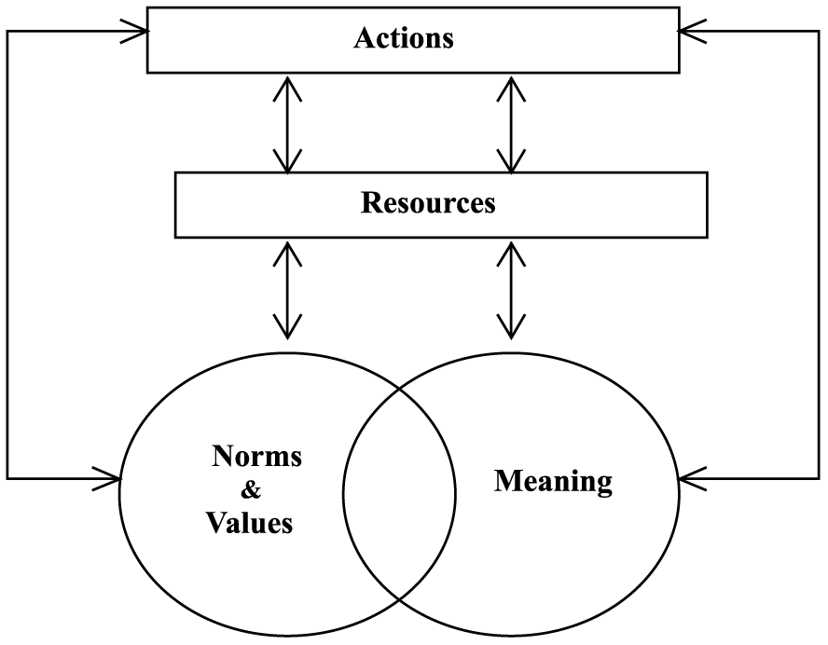
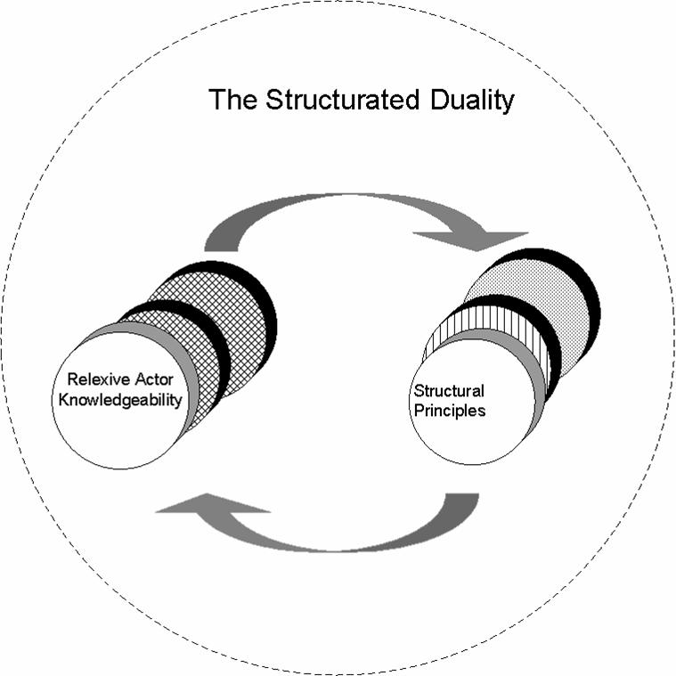
STRUCTURATION

Slide 12
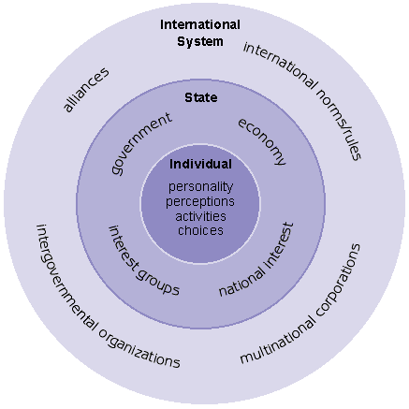
ANARCHY!

Slide 13
Cultures of Anarchy (Alexander Wendt, 1999):

Slide 14
Cultures of Anarchy (Alexander Wendt, 1999):
“Anarchy as such is an empty vessel and has no intrinsic logic; anarchies only acquire logics as a function of the structure of what we put inside them."

Slide 15
Cultures of Anarchy (Alexander Wendt, 1999):
“Anarchy as such is an empty vessel and has no intrinsic logic; anarchies only acquire logics as a function of the structure of what we put inside them."
An international anarchy, whether at the global or regional level, can have any one of three kinds of structure: Hobbesian, Lockean, or Kantian.

Slide 16
Cultures of Anarchy (Alexander Wendt, 1999):
“Anarchy as such is an empty vessel and has no intrinsic logic; anarchies only acquire logics as a function of the structure of what we put inside them."
An international anarchy, whether at the global or regional level, can have any one of three kinds of structure: Hobbesian, Lockean, or Kantian.
Each of these structures is fundamentally constituted by shared ideas among the constituent state members, and these shared ideas in turn “make up the subset of social structure known as ‘culture'." Although there are other aspects to social structures, particularly material aspects, culture – as shared ideas – is “the most fundamental fact about the structure of an international system, giving meaning and power and content to interests."

Slide 17
Cultures of Anarchy (Alexander Wendt, 1999):
“Anarchy as such is an empty vessel and has no intrinsic logic; anarchies only acquire logics as a function of the structure of what we put inside them."
An international anarchy, whether at the global or regional level, can have any one of three kinds of structure: Hobbesian, Lockean, or Kantian.
Each of these structures is fundamentally constituted by shared ideas among the constituent state members, and these shared ideas in turn “make up the subset of social structure known as ‘culture'." Although there are other aspects to social structures, particularly material aspects, culture – as shared ideas – is “the most fundamental fact about the structure of an international system, giving meaning and power and content to interests."
🤯

Slide 18
Cultures of Anarchy (Alexander Wendt, 1999):
Each of the three different kinds of structure centers on a dominant role that state members play.

Slide 19
Cultures of Anarchy (Alexander Wendt, 1999):
Each of the three different kinds of structure centers on a dominant role that state members play.
In Hobbesian cultures, the dominant role (or “subject position”) is “enemy."

Slide 20
Cultures of Anarchy (Alexander Wendt, 1999):
Each of the three different kinds of structure centers on a dominant role that state members play.
In Hobbesian cultures, the dominant role (or “subject position”) is “enemy."
In Lockean cultures it is “rival."

Slide 21
Cultures of Anarchy (Alexander Wendt, 1999):
Each of the three different kinds of structure centers on a dominant role that state members play.
In Hobbesian cultures, the dominant role (or “subject position”) is “enemy."
In Lockean cultures it is “rival."
In Kantian cultures it is “friend."

Slide 22
Cultures of Anarchy (Alexander Wendt, 1999):
Each of the three different kinds of structure centers on a dominant role that state members play.
In Hobbesian cultures, the dominant role (or “subject position”) is “enemy."
In Lockean cultures it is “rival."
In Kantian cultures it is “friend."
Roles are attributes of the structures, not the agents or units. Roles are in this sense “the objective, collectively constituted positions that give meaning to” subjective self-understandings." Particular role-identities may come and go “as individuals [states] take on or discard beliefs,” but roles as objective, collectively constituted positions within the structure “persist as long as someone fills them."

Slide 23
Cultures of Anarchy (Alexander Wendt, 1999):
But what specifically are the central norms of a Hobbesian culture in contradistinction to those of a Lockean or a Kantian culture?

Slide 24
Cultures of Anarchy (Alexander Wendt, 1999):
But what specifically are the central norms of a Hobbesian culture in contradistinction to those of a Lockean or a Kantian culture?
Wendt explains that in a Hobbesian culture enemies are constituted by representations of the Other – that is, through securitization practices – as “an actor who (1) does not recognize the right of the Self to exist as an autonomous being, and therefore (2) will not willingly limit its violence toward the Self…An enemy does not recognize the right of the Self to exist as a free subject at all.”

Slide 25
Cultures of Anarchy (Alexander Wendt, 1999):
In contrast to the Hobbesian culture, in a Lockean culture of anarchy, member states freely agree to recognize and accept each other’s sovereign autonomy as a right while refraining from trying to conquer or dominate other states. To be sure, states might still use violence occasionally against each other, or coercion, but since they are only rivals not enemies, they will not try completely to destroy the other or eradicate the other’s subjectivity/selfhood.

Slide 26
Cultures of Anarchy (Alexander Wendt, 1999):
In contrast to the Hobbesian culture, in a Lockean culture of anarchy, member states freely agree to recognize and accept each other’s sovereign autonomy as a right while refraining from trying to conquer or dominate other states. To be sure, states might still use violence occasionally against each other, or coercion, but since they are only rivals not enemies, they will not try completely to destroy the other or eradicate the other’s subjectivity/selfhood.
When all states party to an interstate society do so recognize each other’s right to autonomous actorhood, “then we can speak of sovereignty not only as a property of individual states, but as an institution shared by many states.”

Slide 27
Cultures of Anarchy (Alexander Wendt, 1999):
In contrast to the Hobbesian culture, in a Lockean culture of anarchy, member states freely agree to recognize and accept each other’s sovereign autonomy as a right while refraining from trying to conquer or dominate other states. To be sure, states might still use violence occasionally against each other, or coercion, but since they are only rivals not enemies, they will not try completely to destroy the other or eradicate the other’s subjectivity/selfhood.
When all states party to an interstate society do so recognize each other’s right to autonomous actorhood, “then we can speak of sovereignty not only as a property of individual states, but as an institution shared by many states.”
Wendt finds that on the global level, most of the world most of the time has been characterized by a Lockean culture of anarchy since the conclusion of WWII.

Slide 28
Cultures of Anarchy (Alexander Wendt, 1999):
Finally there is the Kantian culture, which Wendt perceived as of the late 1990s to have taken root among the US, Canada, most of Europe, Australia, New Zealand, Japan, South Korea, and others, a security community in which member states view each other not even as rivals on the most important questions but instead as friends.
“Friendship is a role structure in which states expect each other to observe two simple rules: (1) disputes will be settled without war or the threat of war (the rule of non-violence); and (2) they will fight as a team if the security of any one of them is threatened by a third part (the rule of mutual aid)."

Slide 29
Cultures of Anarchy (Alexander Wendt, 1999):
Wendt finds there to be four master variables that can cause transition from a Lockean culture to a Kantian culture: interdependence, common fate, homogeneity, and self-restraint. The first three (interdependence, common fate, and homogeneity) are active or efficient causes of collective identity. The last (self-restraint) is an enabling or permissive cause.

Slide 30
Cultures of Anarchy (Alexander Wendt, 1999):
Wendt finds there to be four master variables that can cause transition from a Lockean culture to a Kantian culture: interdependence, common fate, homogeneity, and self-restraint. The first three (interdependence, common fate, and homogeneity) are active or efficient causes of collective identity. The last (self-restraint) is an enabling or permissive cause.
All four may be present in a given case, and the more that are present the more likely collective identity formation will occur. But all that is necessary for it to occur is one efficient cause combined with self-restraint.” Self-restraint has the effect of “enabling states to solve the fundamental problem of collective identity formation overcoming the fear of being engulfed by the Other."

Slide 31
Cultures of Anarchy (Alexander Wendt, 1999):
1. INTERDEPENDENCE. “In order to cause collective identity, interdependence must be objective rather than subjective…The problem is changing objective into subjective interdependence."

Slide 32
Cultures of Anarchy (Alexander Wendt, 1999):
1. INTERDEPENDENCE. “In order to cause collective identity, interdependence must be objective rather than subjective…The problem is changing objective into subjective interdependence."
“When people choose to ‘defect’ in a social dilemma they are simultaneously choosing to reproduce the egoistic identities that constitute the dilemma. And conversely for prosocial behavior: by choosing to cooperate in a social dilemma Ego implicitly takes a collective identity, acting ‘as if’ he cares for Alter, even if this is initially for selfish reasons, and signals to Alter, ‘I expect you to do the same in return’ (altercasting). If Alter reciprocates then Ego’s tentative new identity will be reinforced, leading to further cooperation and, over time, an internalization of collective identity on both sides."

Slide 33
Cultures of Anarchy (Alexander Wendt, 1999):
2. COMMON FATE. “Actors face a common fate when their individual survival, fitness, or welfare depends on what happens to the group as a whole. As with interdependence, this can only cause collective identity if it is an objective condition, since subjective awareness of being ‘in the same boat’ is [already] constitutive of collective identity, not a cause." If both sides already think that subjectively, they already have the collective identity.

Slide 34
Cultures of Anarchy (Alexander Wendt, 1999):
2. COMMON FATE. “Actors face a common fate when their individual survival, fitness, or welfare depends on what happens to the group as a whole. As with interdependence, this can only cause collective identity if it is an objective condition, since subjective awareness of being ‘in the same boat’ is [already] constitutive of collective identity, not a cause." If both sides already think that subjectively, they already have the collective identity.
The emergence of perceptions of common fate may depend on ‘entrepreneurs’ and/or ‘epistemic communities’ who take the lead in reframing how actors understand themselves. Such leadership is not always present.”

Slide 35
Cultures of Anarchy (Alexander Wendt, 1999):
2. COMMON FATE. “Actors face a common fate when their individual survival, fitness, or welfare depends on what happens to the group as a whole. As with interdependence, this can only cause collective identity if it is an objective condition, since subjective awareness of being ‘in the same boat’ is [already] constitutive of collective identity, not a cause." If both sides already think that subjectively, they already have the collective identity.
The emergence of perceptions of common fate may depend on ‘entrepreneurs’ and/or ‘epistemic communities’ who take the lead in reframing how actors understand themselves. Such leadership is not always present.”
But common fate is not a sufficient condition for collective identity formation because as with interdependence, actors may fear exploitation by others in the collective…Believing that those with whom one might cooperate will exhibit self-restraint is therefore an important condition."

Slide 36
Cultures of Anarchy (Alexander Wendt, 1999):
3. HOMOGENEITY. “The concept of collective identity presupposes that members categorize themselves as being alike along the dimensions that define the group, and as such the perception of homogeneity helps constitute collective identity. The causal relationship, therefore, must be between ‘objective’ homogeneity and its subjective categorization...The hypothesis would be that increases in objective homogeneity cause actors to recategorize others as being like themselves."

Slide 37
Cultures of Anarchy (Alexander Wendt, 1999):
3. HOMOGENEITY. “The concept of collective identity presupposes that members categorize themselves as being alike along the dimensions that define the group, and as such the perception of homogeneity helps constitute collective identity. The causal relationship, therefore, must be between ‘objective’ homogeneity and its subjective categorization...The hypothesis would be that increases in objective homogeneity cause actors to recategorize others as being like themselves."
“Inventing or problematizing new sources of group differentiation shores up the boundary between the group Self and the Other. This need for difference does not have to lead to aggression or disrespect toward other groups (to ‘Othering’), and need not block the formation of a collective identity on other issues. But it does weaken the relationship between homogenization and prosocial behavior.

Slide 38
Cultures of Anarchy (Alexander Wendt, 1999):
4. SELF-RESTRAINT. “Interdependence, common fate, and homogeneity are efficient causes of collective identity formation and thus structural change. As they increase actors have more incentive to engage in prosocial behavior, which erodes egoistic boundaries of the Self and expands them to include the Other. This process can only proceed, however, if actors can overcome their fear of being engulfed, physically or psychically, by those with whom they would identify.

Slide 39
Cultures of Anarchy (Alexander Wendt, 1999):
4. SELF-RESTRAINT. “Interdependence, common fate, and homogeneity are efficient causes of collective identity formation and thus structural change. As they increase actors have more incentive to engage in prosocial behavior, which erodes egoistic boundaries of the Self and expands them to include the Other. This process can only proceed, however, if actors can overcome their fear of being engulfed, physically or psychically, by those with whom they would identify.
In order to get past this threat, which is the source of egoism and ‘Realism,’ actors must trust that their needs will be respected, that their individuality will not be wholly submerged by or sacrificed to the group. Creating this trust is the fundamental problem of collective identity formation, and is particularly difficult in anarchy, where being engulfed can be fatal."

Slide 40
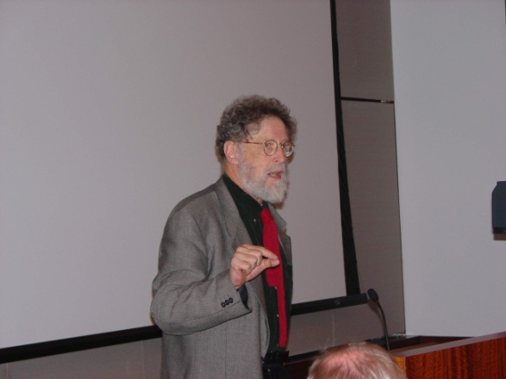

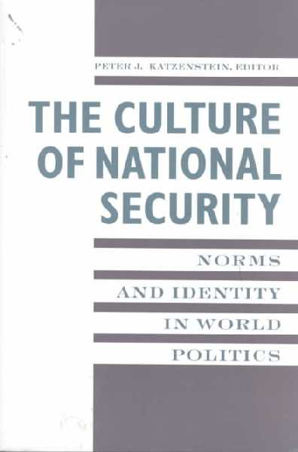

Constructivism and Military Security
Jepperson, Wendt, and Katzenstein:

Slide 41
Constructivism and Military Security
Jepperson, Wendt, and Katzenstein: The security environments in which states find themselves embedded are NOT just material (e.g., balance of military power), but also—importantly, and even DECISIVELY—cultural or institutional.

Slide 42
JWK’s “Three Layers” to the
International Cultural Environment (ICE)

Slide 43
JWK’s “Three Layers” to the
International Cultural Environment (ICE)
1. The layer of formal institutions or security REGIMES.

Slide 44
JWK’s “Three Layers” to the
International Cultural Environment (ICE)
1. The layer of formal institutions or security REGIMES.
2. A world political culture layer.

Slide 45
JWK’s “Three Layers” to the
International Cultural Environment (ICE)
1. The layer of formal institutions or security
REGIMES.
2. A world political culture layer.
3. A layer consisting of enduring patterns of amity
and enmity, particularly within regions.

Slide 46
JWK’s “Three Layers” to the
International Cultural Environment (ICE)
1. The layer of formal institutions or security REGIMES.
2. A world political culture layer.
3. A layer consisting of enduring patterns of amity and enmity, particularly within regions.
FOR EXAMPLE:

Slide 47
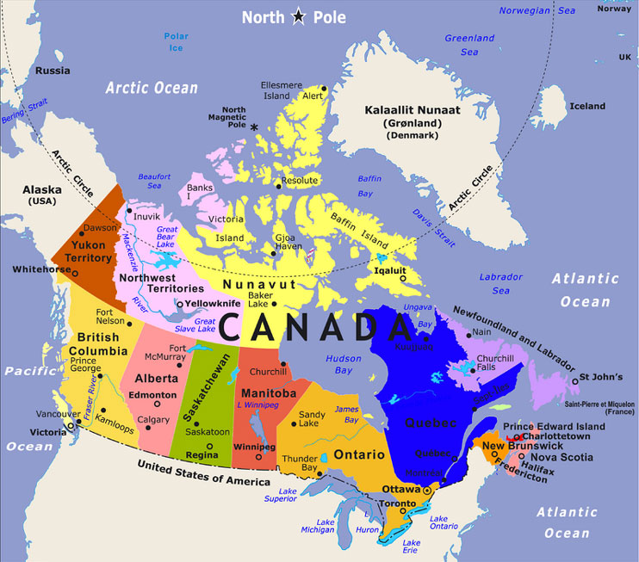
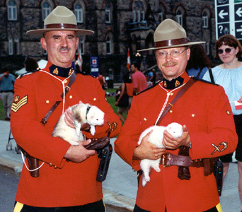
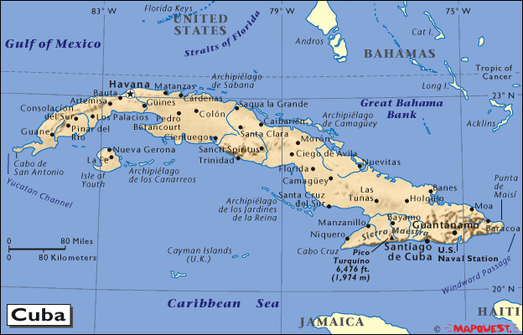
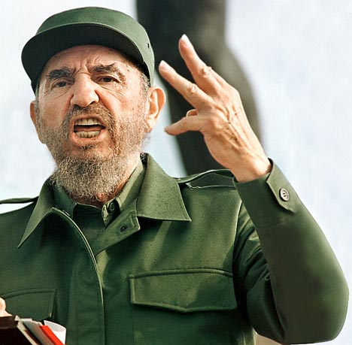
Which country is – to the U.S. – the nice country?

Slide 48
JWK’s Key Novel Argument
Elements of the international cultural environment don’t just affect the incentives facing states to behave in certain kinds of ways.

Slide 49
JWK’s Key Novel Argument
Elements of the international cultural environment don’t just affect the incentives facing states to behave in certain kinds of ways.
The ICE also affects the basic character of the states: their identities.

Slide 50
BREAKTHROUGH:
From the Neo-Neo Debate to the Neo-Neo Synthesis
“We reject the prevailing assumption, shared by Neorealists and Neoliberals alike, that the defining actor properties are intrinsic to states, that they are all power-seeking and (material) interest-maximizing rational actors.”

Slide 51
BREAKTHROUGH:
From the Neo-Neo Debate to the Neo-Neo Synthesis
“We reject the prevailing assumption, shared by Neorealists and Neoliberals alike, that the defining actor properties are intrinsic to states, that they are all power-seeking and (material) interest-maximizing rational actors.”
🤯

Slide 52
The ICE’s Three Effects on
State Identities

Slide 53
The ICE’s Three Effects on
State Identities
1. Elements of it can affect some states’ very prospects for survival.

Slide 54
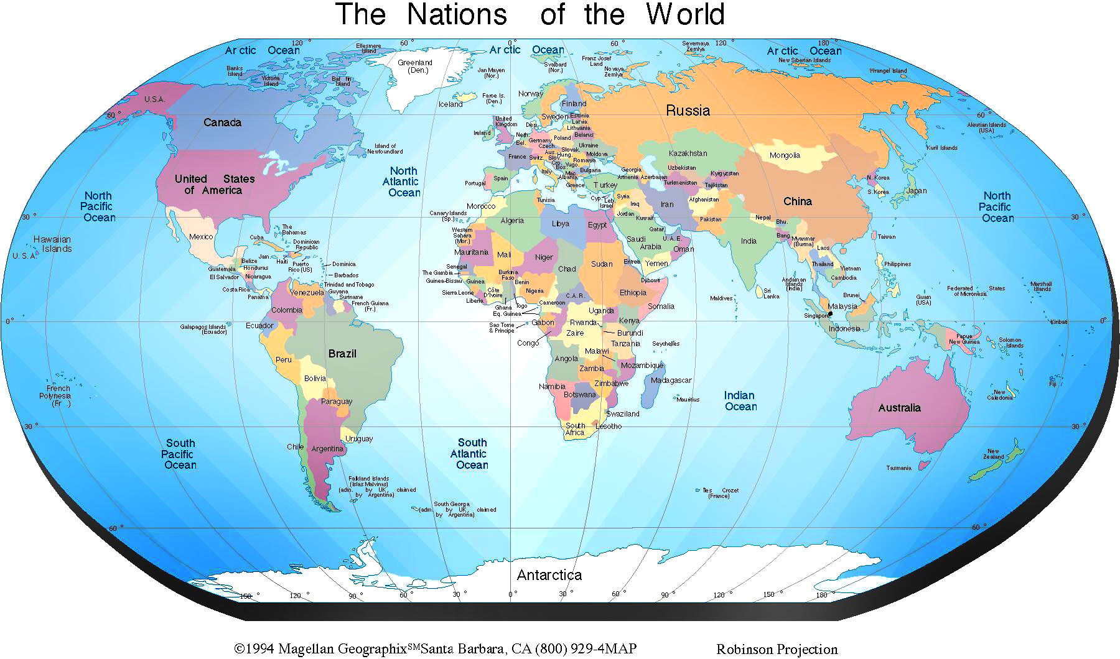

Slide 55
The ICE’s Three Effects on
State Identities
1. Elements of it can affect some states’ very prospects for survival.
2. Changing ICE elements may change “the modal character of statehood” over time.

Slide 56
The ICE’s Three Effects on
State Identities
1. Elements of it can affect some states’ very prospects for survival.
2. Changing ICE elements may change “the modal character of statehood” over time.
3. ICE elements may cause variation in the character of statehood within a given international society: so states may be similar in structure and function, but be compelled by norms to play different roles.

Slide 57
6 Primary Norms of Imperialism

Slide 58
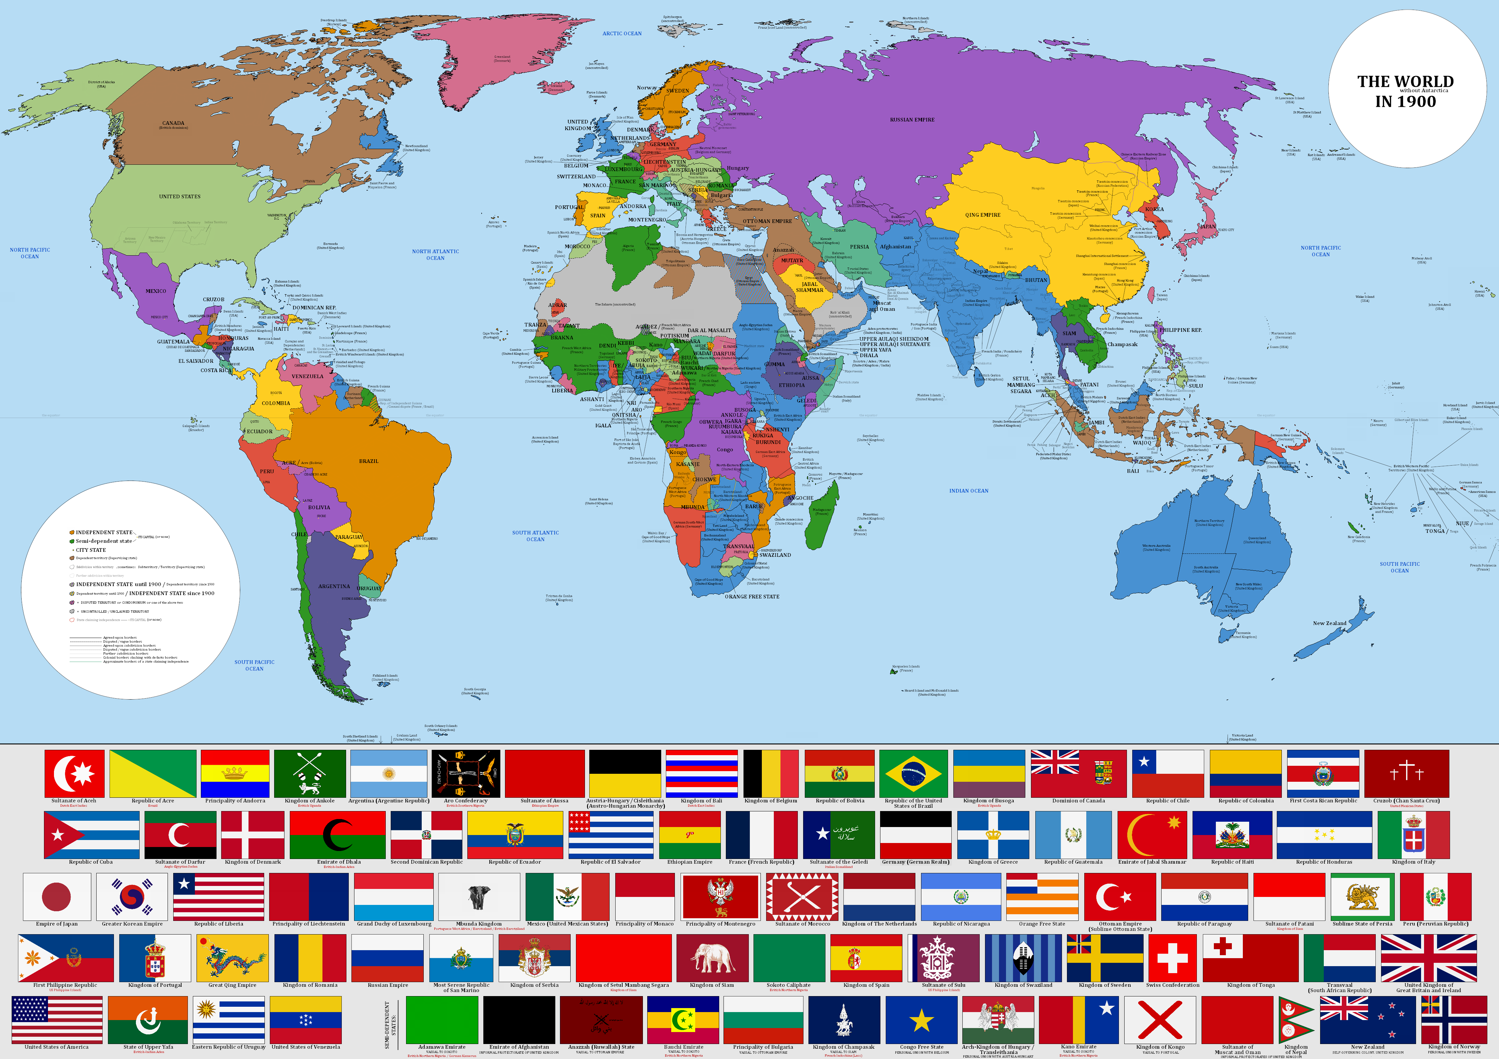

Slide 59
6 Primary Norms of Imperialism
1. The world is divided into civilized and uncivilized realms.

Slide 60
6 Primary Norms of Imperialism
2. To rule over foreigners was acceptable.

Slide 61
6 Primary Norms of Imperialism
3. Accumulating a domain was a legitimate state pursuit.

Slide 62
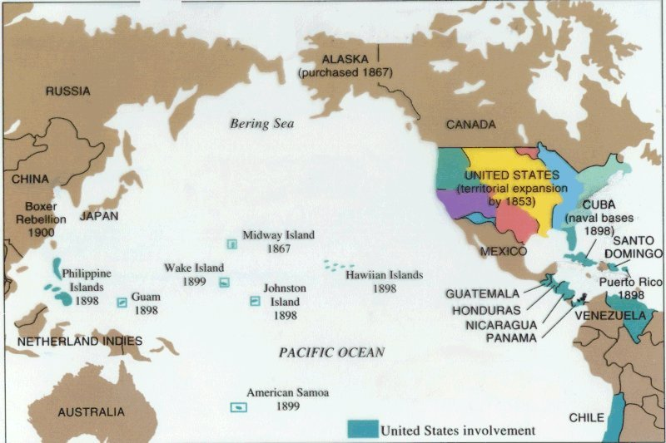
US imperialism in the Pacific and in “its own backyard”

Slide 63
6 Primary Norms of Imperialism
4. Power should be balanced.

Slide 64
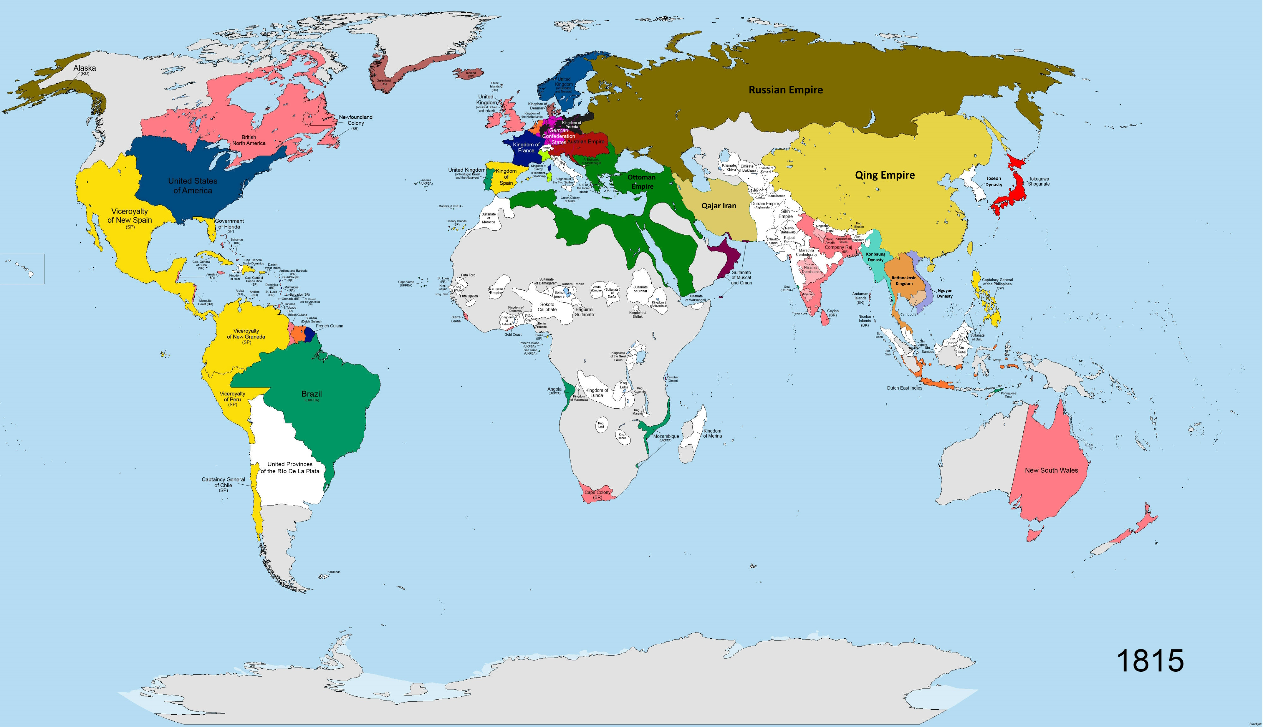

Slide 65
6 Primary Norms of Imperialism
5. Mercantilist economic policies were legitimate.

Slide 66
6 Primary Norms of Imperialism
6. States should not interfere in other states’ colonial administration.

Slide 68
Challenges to Constructivism

Slide 69
Challenges to Constructivism
The Realist Critique: Does constructivism pay enough attention to the hard realities of military and economic power? Realists argue that while norms are nice, they are ultimately secondary to material capabilities and survival instincts.

Slide 70
Challenges to Constructivism
The Realist Critique: Does constructivism pay enough attention to the hard realities of military and economic power? Realists argue that while norms are nice, they are ultimately secondary to material capabilities and survival instincts.
The Rationalist Critique: Are concepts like identity and culture too vague and difficult to measure? Critics from neoliberalism and neorealism argue that constructivism lacks the predictive power of rational-choice models.

Slide 71
Challenges to Constructivism
The Realist Critique: Does constructivism pay enough attention to the hard realities of military and economic power? Realists argue that while norms are nice, they are ultimately secondary to material capabilities and survival instincts.
The Rationalist Critique: Are concepts like identity and culture too vague and difficult to measure? Critics from neoliberalism and neorealism argue that constructivism lacks the predictive power of rational-choice models.
The Problem of Change: Constructivism is great at explaining how norms create stability and constrain actors. It is often seen as weaker at explaining where norms come from in the first place or why they sometimes collapse suddenly.

Slide 72
Challenges to Constructivism
The Realist Critique: Does constructivism pay enough attention to the hard realities of military and economic power? Realists argue that while norms are nice, they are ultimately secondary to material capabilities and survival instincts.
The Rationalist Critique: Are concepts like identity and culture too vague and difficult to measure? Critics from neoliberalism and neorealism argue that constructivism lacks the predictive power of rational-choice models.
The Problem of Change: Constructivism is great at explaining how norms create stability and constrain actors. It is often seen as weaker at explaining where norms come from in the first place or why they sometimes collapse suddenly.
The “Good Norms” Problem: The theory effectively explains the spread of both good norms (human rights) and bad norms (imperialism, slavery). It provides a tool for understanding process, but not for assessing the moral content of ideas.

